Slide 1
City of Pittsburgh
Budget Engagement
Office of Management and Budget

Slide 2
Office of Management and Budget Overview
OMB has five functional areas:
Administration
Capital, Fleet, and Asset Management
Community Development Block Grant (CDBG)
  CDBG
  Emergency Solutions Grant
  Housing Opportunities for Persons with AIDS
  HOME Investment Partnership programs
Operating, Grants, and Special Revenue
Procurement
Notes:
CDBG - (U.S. Department of Housing and Urban Development)

Slide 3

Funding City Services
Revenue Sources
OMB
Money in
Money out
Finance
Departments
(City Services)
Notes:
Department of Finance – completely separate entity responsible for collecting taxes

Slide 4
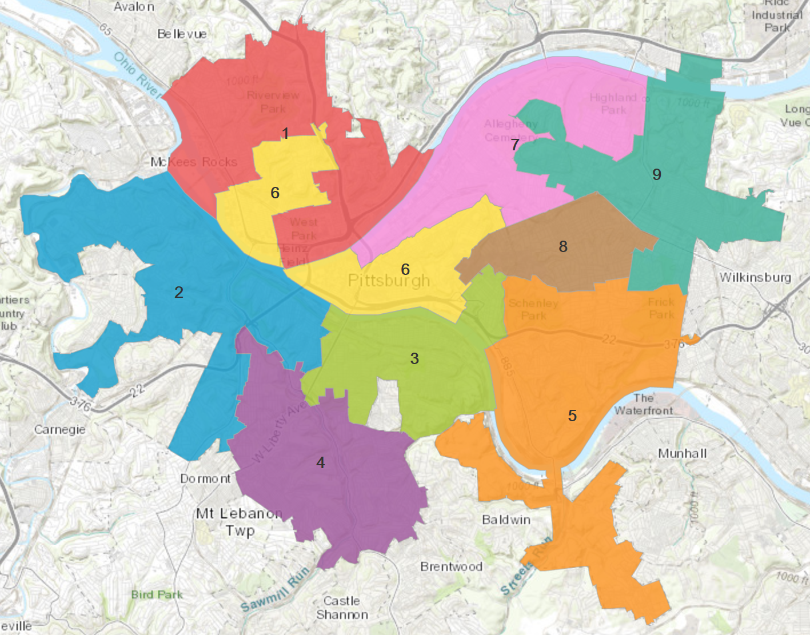
Jurisdiction of City Services
The City does not have responsibility for services outside of the nine colored Council Districts below
Notes:
The City sometimes signs inter-governmental cooperation agreements to partner with neighboring boroughs and townships
Examples – Wilkinsburg fire and refuse

Slide 5
Jurisdiction of City Services
The City does not have legal authority over the following:
  County, state, or federal roads and bridges
  Schools (Pittsburgh Public Schools)
  Public transportation (Port Authority of Allegheny County)
  Health services (Allegheny County)
  Most human services (Allegheny County)
  The jail (Allegheny County)
  Courts (county, state, federal)
  Non-City of Pittsburgh public safety response teams
  Water infrastructure (PWSA, ALCOSAN)
  Public parking infrastructure and enforcement (Pittsburgh Parking Authority)
Notes:
Again, the City sometimes signs inter-governmental cooperation agreements to partner with these organizations
Examples – Ft. Pitt is a federal bridge, Liberty is state, Clemente/Warhol/Rachel Carson is county, Greenfield is city

Slide 6
Two Budgets
The Operating Budget funds expenditures that pay for most day-to-day governmental activities
The Capital Budget funds projects that are:
  Used to design, build, restore, retain, or purchase any City-owned asset
  Have a minimum value of $50,000
  Have a minimum useful life of five years
  Primarily funded via municipal bonds (debt issuance), pay-as-you-go (an annual operating transfer), or federal/state funding (CDBG, DCED, etc.)
Notes:
Federal and state funding may have extra restrictions on the use of capital dollars above and beyond City restrictions
** Unlike the Operating Budget, the Capital Budget is not ‘use it or lose it’ – funds remain available until a project is delivered or are re-allocated to a more immediate need

Slide 7
What Does Each Budget Fund?
Operating Budget
Employee salaries and benefits
Pension funding
Debt payments
Leases
Utility payments
Ongoing building maintenance
Fuel and vehicle maintenance
Office supplies
Computers and software
Internet for City facilities
Professional services
Capital Budget
Construction and major renovations of:
  Roads (including paving and traffic signals)
  Bridges
  Public sidewalks
  Public parks
  Healthy Active Living centers
  Recreation centers
  City-owned buildings
City vehicles and heavy equipment
Major new technology projects
Public neighborhood support (CDBG)
Notes:
Leases – Police HQ, West End Healthy Active Living Center
Professional – auditing services for accounting, software for 311, online permitting and licensing

Slide 8
Key Home Rule Charter Summaries
§ 502. - OPERATING AND CAPITAL BUDGET.
  There shall be an annual balanced operating budget
  There shall be an annual capital budget
§ 504. - PREPARATION OF OPERATING AND CAPITAL BUDGETS.
  The Mayor’s Office shall conduct public hearings for both budgets
§ 505. - PRESENTATION AND ADOPTION OF BUDGETS.
  The Mayor presents the proposed budgets to Council each November
  Council must legally adopt both budgets by the end of December
§ 507. - AMENDMENT OF BUDGET.
  Council may amend operating budget until the first week of February
    After five weeks, the Mayor and Council must work together to amend the budget
  The capital budget may be amended at any time
§ 508. - CAPITAL PROGRAM.
  The capital budget shall include a six year plan

Slide 9
Key Code Provisions
CHAPTER 218: - CAPITAL BUDGET AND CAPITAL IMPROVEMENT PLAN
  Definition of a capital project
  Creation of the Capital Program Facilitation Committee
  Project procurement and accounting
  Quarterly reports
CHAPTER 219: - OPERATING BUDGET
  Five-year plan
  Preliminary September budget
  Quarterly reports
  Fund balance minimums
  Pension contribution minimums
  Fiscal impact statements for each submitted resolution and ordinance

Slide 10
General Timeline
April: The Mayor sets budget priorities
May:
  Capital only – OMB issues requests for project proposals from departments, Council, and key community partners
June: OMB and the Office of Community Affairs host public engagement for both documents
  Operating only – OMB releases materials to departments
July: Requests are due to OMB
August:
  Capital only – the CPFC presents its summary report to OMB
  Operating only – OMB and departments discuss requests with the Mayor

Slide 11
General Timeline
September: The Mayor makes final decisions; the preliminary budget is published
October: The preliminary budgets are finalized
November: The Mayor delivers the State of the City address and presents both budgets to City Council
December: Council holds budget hearings, revises the documents, and passes them into law by December 31st

Slide 12
Public Engagement
It’s important to engage with OMB because we are directing your taxpayer dollars. Your input is critical!
Engagement includes:
  This kick-off presentation
  Attending public meetings for both budgets
  Reading educational guides in the budget documents
  Completing surveys
  Submitting online budget simulations
  Interacting with 311, departments, the Mayor’s Office, and City Council offices
Public input will be reported to department directors, the Mayor’s Office, and City Council

Slide 13
Resources
OMB: http://pittsburghpa.gov/omb/omb.html
  Operating budgets: https://pittsburghpa.gov/omb/budgets-reports
  Capital budgets: https://pittsburghpa.gov/omb/capital-budgets
  Budget in Brief: https://pittsburghpa.gov/omb/budget-brief
  Quarterly reports: https://pittsburghpa.gov/omb/quarterly-reports
EngagePGH: https://engage.pittsburghpa.gov/
Contact Information:
  Operating team: OMBoperating@pittsburghpa.gov
  Capital team: cip@pittsburghpa.gov

Slide 14
Thank You!
We appreciate your time and civic engagement.

