Slide 1

CITY OF PITTSBURGH
2026 Public Service (PSG)
Application Information
Session
March 18, 2026

Slide 2

Presenters
AJ Miller, Program Supervisor
Michael Knight, Fiscal and Contracting Supervisor
Notes:
Kelly

Slide 3
Agenda
Source of Public Service Grant
Program Overview and Updates
Eligible Organizations and Activities
Public Service Grant Application
Notes:
Kelly

Slide 4
Source of Public Service Grant
Public Service Grant funding comes from the Community Development Block Grant (CDBG) program, part of the Federal Budget.
CDBG is administered by the U.S. Department of Housing and Urban Development (HUD).
Most funds go to City infrastructure projects, but $550,000 is available for the Public Service Grant, which is used by nonprofits providing direct benefits to low-mod residents.
Notes:
Kelly

Slide 5
Process Overview
  Reimbursement grant
  Grantee nonprofit (“subrecipient”) pays for goods and services
  Subrecipient submits supporting documents to the City after contract execution
  City issues check to subrecipient
Notes:
Kelly

Slide 6
Program Update for 2026
Applications will be entered on Bridgeway software
Recommended request: $10,000-$25,000
  $10,000 minimum, $50,000 maximum
Focus on projects directly providing services to low- to moderate-income clients
Timeline:
Applications are due Tuesday March 31, 2026 at 11:59 PM
Decisions on awards will not be available until late Fall 2026
Contracts will not be executed until January 2027
Expenses before January 2027 will not be reimbursable
Notes:
Kelly
Main update is the software, but highlight that we’re sticking with the $10k minimum/$50k maximum, LMC focus, and extended timeline.

Slide 7
Is Your Organization Eligible?
Organizations seeking Public Service funds must:
Have 501(c)(3) non-profit tax status
    Articles of Incorporation
    Written bylaws
Have a mission that supports City of Pittsburgh residents
Demonstrate financial management capacity
Have filed an IRS Form 990 (990-N, 990-EZ, or 990) last year
No fiscal sponsors will be allowed
Notes:
Kelly
Now to go into the logistics of applying for 2026 funds. On this slide you see the eligibility requirements for applicants. Organizations interested in Public Service funding must have a 501(c)3 status and be current on annual filings to the IRS. If your organization has not filed a 990 last year, you will need to attach a letter on your letterhead explaining why—this should only affect churches and newly formed organizations.

Slide 8
Is Your Organization Eligible?
Organizations seeking Public Service funds must:
Have an active registration through SAM.gov
Have no outstanding financial liabilities with the City of Pittsburgh, or demonstrate an approved payment plan
Have current general liability insurance
Have current worker's compensation insurance (only required if organization has paid staff)
Notes:
Kelly
Here are more eligibility criteria for organizations. All applicants must have an active registration on SAM.gov. Organizations will need to create a profile on SAM.gov to secure a UEI for their organization. If you don't have one already, start the process to obtain a UEI IMMEDIATELY. Along with the UEI, organizations should also be in good financial standing with the City of Pittsburgh and have appropriate insurance. All organizations must have general liability insurance and, if an organization has paid staff, they must also have worker's compensation insurance.

Slide 9
Is Your Organization Eligible?
Registration through SAM.gov
All organizations must be registered through SAM.gov
  If your organization is not registered, start the process now!
  Registration is more than just the Unique Entity ID (UEI)
  SAM.gov registrations must be renewed annually
Go to our Subrecipient Resources webpage for guides to register on SAM.gov
Notes:
Kelly
Here are more eligibility criteria for organizations. The first bullet describes a newer requirement for applications. Last year the Federal Government required that all applicants obtain a Unique Entity ID (UEI). Organizations will need to create a profile on SAM.gov to secure a UEI for their organization. We have linked resources on obtaining a UEI including a video explaining the process on the application webpage and on these slides. If you don't have one already, start the process to obtain a UEI IMMEDIATELY. Along with the UEI, organizations should also be in good financial standing with the City of Pittsburgh and have appropriate insurance. All organizations must have general liability insurance and, if an organization has paid staff, they must also have worker's compensation insurance.

Slide 10
Is Your Organization Eligible?
Insurance Requirements
General liability insurance:
  All applicants must maintain general liability insurance during the contract term with the City listed as additionally insured
    Certificate of Insurance must state "The City of Pittsburgh is additional insured in terms of general liability insurance" and have the City's address in the Certificate Holder section
Worker's Compensation for organizations with paid staff
  If your organization has no paid staff, you will submit a waiver
Notes:
Kelly

Slide 11
Is Your Project Eligible?
For Public Service Grant, CDBG funds MUST:
Serve people that have low or moderate incomes
Fit within one of the eligible project categories
Notes:
Kelly
As Kelly mentioned earlier, these funds must be used to serve Pittsburgh residents with low and moderate incomes. In your application you will need to select that your project is serving either a specific population presumed to meet income guidelines called "presumed benefit" otherwise your program will need income verify the people you are serving.
Emphasize that organizations must be able to prove the eligibility of their beneficiaries

Slide 12
Is Your Project Eligible?
How does the City check that your project serves low- and moderate- income residents? Your organization must prove either:
  All clients are members of a specific eligible population group
  OR
  At least 51% of program clients are Pittsburgh residents with low or moderate incomes
Notes:
Kelly
As Kelly mentioned earlier, these funds must be used to serve Pittsburgh residents with low- and moderate- incomes. In your application you will need to select that your project is serving either a specific population presumed to meet income guidelines called "presumed benefit" otherwise your program will need income verify the people you are serving.

Slide 13
Presumed Benefit Populations
Some populations are generally presumed to be principally low- and moderate-income persons:
  Abused children
  Older adults (aged 62+)
  Victims of Intimate Partner Violence
  Persons experiencing homelessness
  Illiterate adults
  Persons living with AIDS
  Migrant farm workers
  Severely disabled adults (as defined by the Census Bureau)
Notes:
Kelly
This slide lists the populations that are considered "Presumed Benefit" by the federal government
If your project serves exclusively members of one of these populations, your program is CDBG eligible
If your program as a whole serves other populations as well as one of these, you can either prove all client income OR only use funding for these specific clients
A note on severely disabled adults—this is the Census Bureau definition which includes "an adult unable to perform one or more functional activities or needs assistance with an Activity of Daily Living or Instrumental Activity of Daily Living" and "persons under 65 ears of age who are covered by Medicare or receive SSI"
If you are not serving one of these specific groups, you will have to prove client income

Slide 14
Clientele Income Verification
Information Required:
Family size and income from every family member 18 and over
Gross income before any payroll deductions
Income source must be current (within 90 days)
Annual Income Includes:
Wages, salaries, overtime pay, commissions, fees, tips and bonuses
Unemployment payments
Disability compensation
Worker’s compensation
Severance pay
Alimony and child support payments
Net income from the operation of a business or profession
Temporary Assistance for Needy Families (TANF)
Social Security and Social Security Income
Notes:
AJ
Most applicants will need to follow these guidelines for income verification.

Slide 15
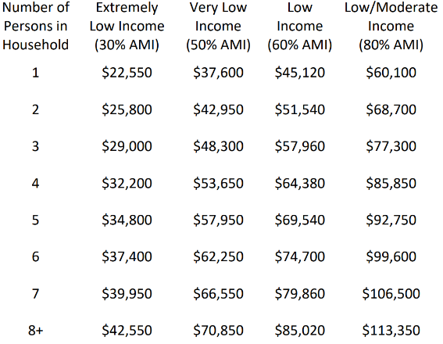
Income Limits
Notes:
AJ
Once organizations verify the income and household size of their clients, they should use this table to ensure that the client does not exceed the 80% AMI limit on the right of this table. These limits are based on Pittsburgh's median income and are updated annually. All awarded organizations will receive a copy of these income limits.
Source: https://www.hudexchange.info/resources/documents/Basically-CDBG-Chapter-3-Nat-Obj.pdf

Slide 16
Income Verification Examples
Client intake form/pay stub verification
Eligibility for Free/Reduced Lunch
Enrollment in other federal assistance programs
Please be aware you must verify income or eligibility status of EVERY INDIVIDUAL served with this funding
Notes:
AJ
Organizations conducting income verification have done this in a few acceptable ways.
Many organizations ask their clients to complete an intake form listing their household size, income of adults in household and reviewing income documentation like a pay stub.
Other organizations have worked with clients already enrolled in another federal program that requires income eligibility. For example, youth eligible for the free lunch program are also eligible for Public Service grant funding. Also, some organizations focus their Public Service funded project in Housing Authority residences.
Must income verify each individual served—don't use estimates or averages to determine client eligibility

Slide 17
Project Types
The CDBG regulations allow the use of grant funds for a wide range of public service activities, including, but not limited to:
Food banks
Senior Services
Teen Services (ages 13-19)
Children’s Services (ages 0-12)
Services for Adults with Disabilities
Employment Training
Substance Abuse Services
Physical Health Services
Transportation
Mental Health Services
Services for Individuals Experiencing or At Risk of Homelessness
Services for Individuals with HIV/AIDS
Intimate Partner Violence Services
Housing Counseling
Tenant/Landlord Counseling
Legal Services
Crime Awareness/Public Safety
Notes:
AJ
This is a list of the various types of projects that the Public Service grant can fund this year. The application will ask you to select from this list of projects.

Slide 18
Application Overview
Available online through Bridgeway, our application portal
Grant request minimum: $10,000
Deadline: Tuesday March 31, 2026
Notes:
AJ
Applications will only be accepted through the new grant portal and they must be submitted by Monday April 7 at 5PM. This is a hard deadline! Remember, this year grants will be larger and less funding will be available overall.
Now let's look at the grant application page:
Much of the information in this presentation is written on this page. In particular note the resources for obtaining a UEI and the Q&A session registration link.
After reviewing this information you can scroll down to the application.
This application must be completed in one sitting, if you refresh the page you will lose your progress. We have provided a word document where you can draft your answers and then paste into this application.
The first section of this application asks for organization information including: contact information, nonprofit status, and insurance
After, is where you will describe your organization's project and who you are serving
Finally, at the bottom of the application you see where to upload attachments and how you will submit the application.

Slide 19
Attachments
Your application is not complete unless you submit these attachments at the end of the online application:
501(c)(3) non-profit tax exemption determination letter from the IRS
Articles of Incorporation
Organization bylaws
Most recent IRS Form 990 (or 990-N/990-EZ)*
Board resolution or meeting minutes affirming approval of the PS 2026 application submission
Procurement Policy
Notes:
AJ
Pay close attention to this list of attachments! If your organization has not filed a 990 last year, you will need to attach a letter on your letterhead explaining why—this should only be for churches and newly formed organizations. An important change is that we will be requiring a board resolution/meeting minutes showing approval for the application submission.
Attachment E is a board resolution approving your application submission. Let us know as soon as possible if you will have difficulty passing this resolution in time for the deadline. If any of these attachments are too large for our website contact us.

Slide 20
Submitting an Online Application
All applicants will need to complete a three-part process:
  Part 1: Create a new account
  Part 2: Add your organization
  Part 3: Create a new submission
Click Here to go to Online Application Website
Applications will ONLY be accepted through this portal
Notes:
AJ
After uploading all your attachments you can submit your application. Again we will only accept online applications.
You can save your application and return to it at a later time, but you will not be able to edit it after submission.

Slide 21
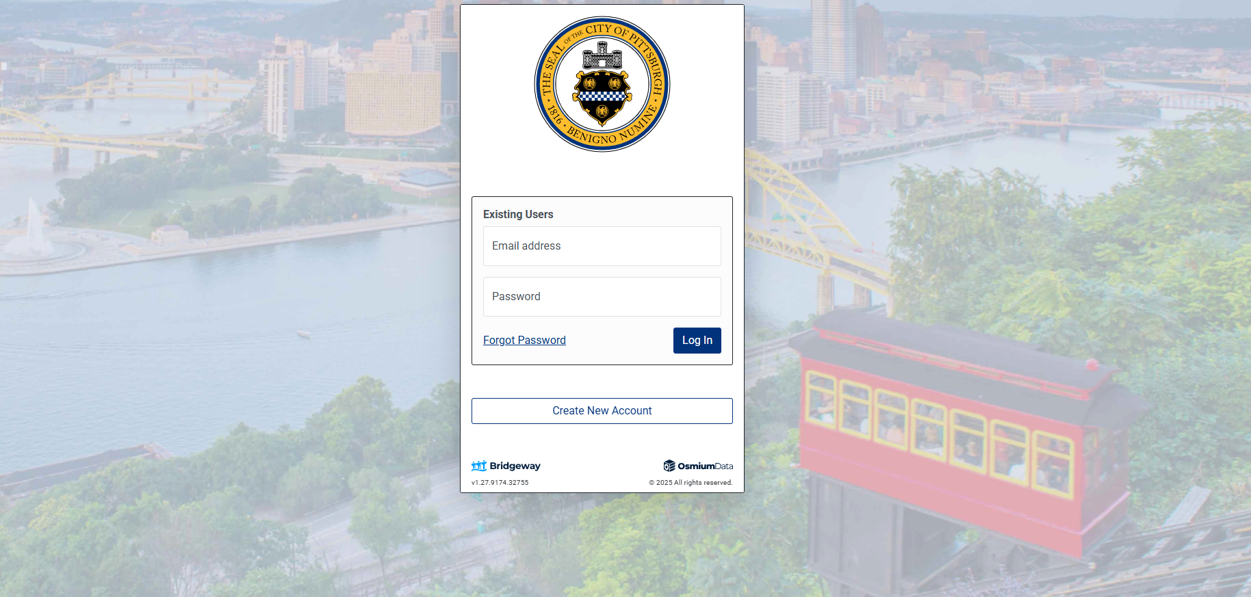
Part 1: Create an Account
Notes:
AJ
If you haven’t been on Bridgeway, create a account. If you have, log in

Slide 22
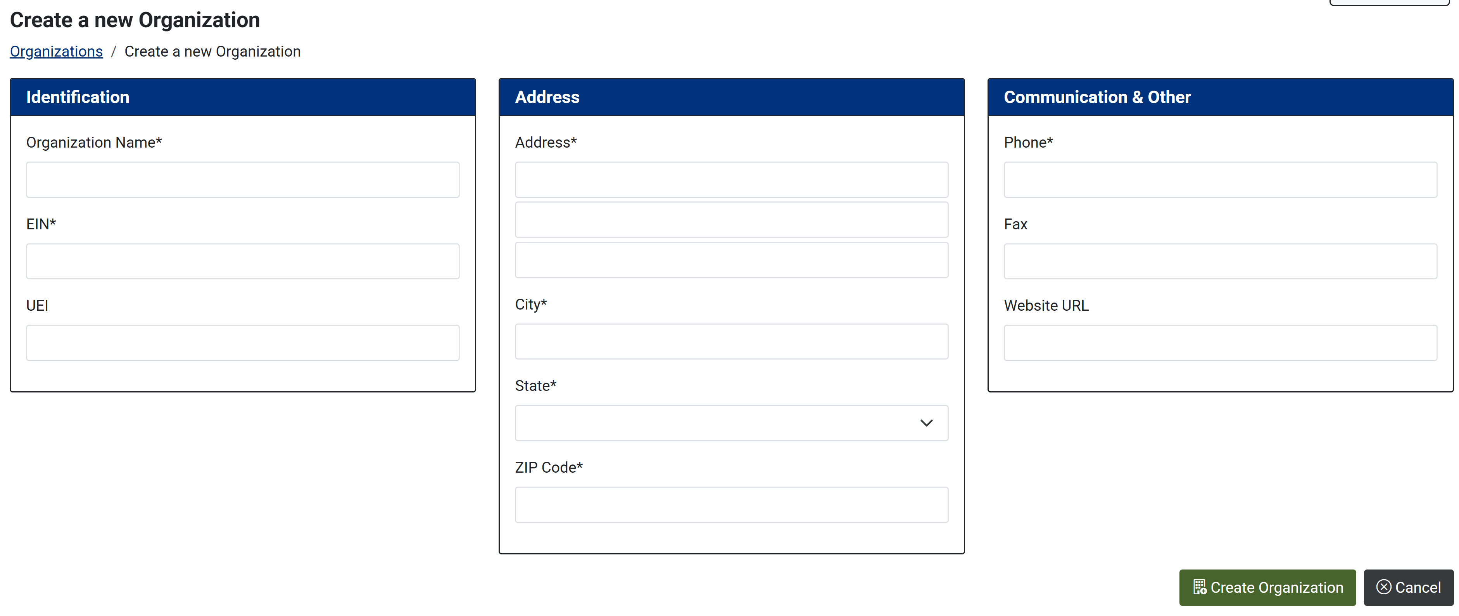
Part 2: Create an Organization
Notes:
AJ
In order to submit an application, you must be part of an application
The first person that creates an organization will become the admin
Use the legal name of your organization—what you would write on your 990
Make sure you have your organization's EIN

Slide 23
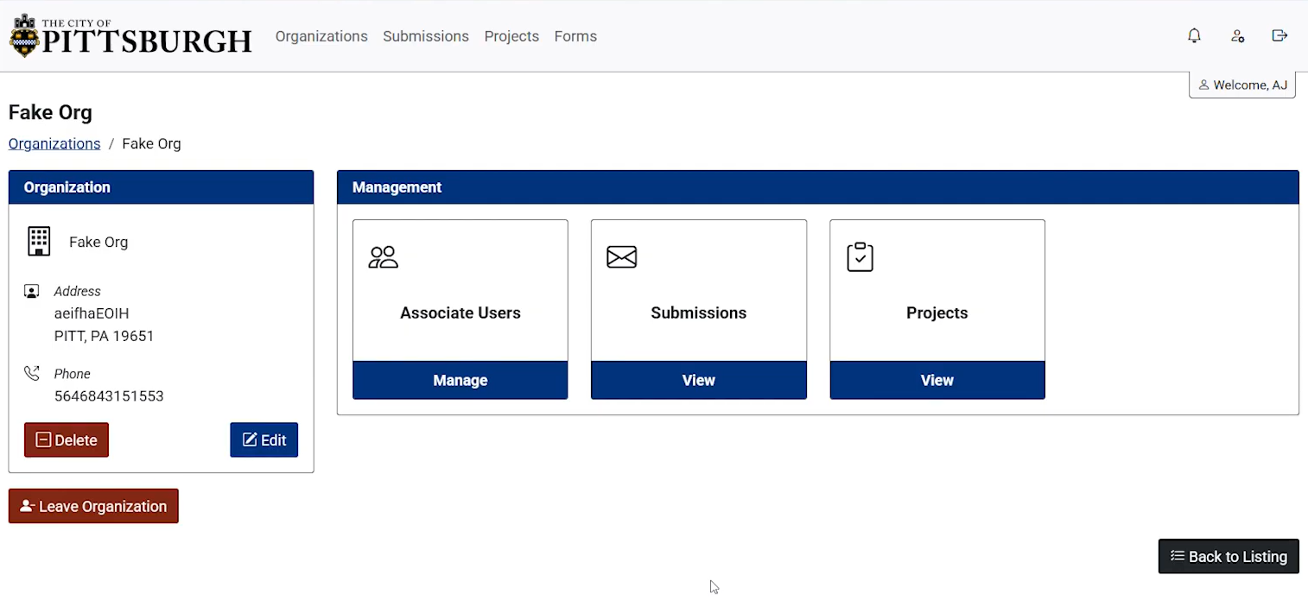
Part 3: Create a New Submission
Notes:
AJ
Watch the video on engage for more details

Slide 24
Online Application Key Takeaways
Individuals must have a Bridgeway account and add their organization BEFORE they can submit an application
You can save your application and continue it at a later time
For the budget question, you can add multiple line items by clicking add another button
In order to submit your application you will need to upload all attachments
After submitting your application, you CANNOT make edits
Applications will ONLY be accepted through this portal
Notes:
AJ
You can save your application and return to it at a later time, but you will not be able to edit it after submission.

Slide 25
Timeline
Tuesday March 31, 11:59 PM - Application due date
April 2026- OMB-CD Reviews Applications for Eligibility
May 2026 –Mayor and Council Offices review applications and make preliminary funding decisions
Late Fall 2026 – HUD approval and City Council Legislation of funding decisions
November 2026 – Awards announced
January 2027 – Contracts begin
Notes:
AJ

Slide 26
Questions/Comments?
Follow-up questions or concerns:
  Email: community.development@pittsburghpa.gov
  Website: https://engage.pittsburghpa.gov/public-service-grants
Notes:
AJ
If you have any follow up question, email our office or check the application website

Slide 27
Questions?
Raise your hand or write in the chat
Notes:
Kelly

Slide 28
Thank You!
WE APPRECIATE YOUR TIME
Notes:
Kelly
Thank you for listening to the end of this presentation and a sincere thank you for good work in our communities.

