Slide 1
This template document may be used by applicants to organize their Visual Materials for applications to the Public Art & Civic Design Commission. It may also be used to create a presentation for a Briefing at the Public Art & Civic Design Commission.
If utilizing this template, please remove all template text and images and add your own.
Additional pages may be added as necessary. There is no size limit for Project Materials submitted with an application.
As project scopes vary widely, each project will have unique needs. The project materials may differ from those listed here but should give as complete of an understanding of the proposal as possible.

Slide 2
Project Name
Date (month, year)
Review type (Briefing, Preliminary, or Hearing & Action)
An introductory title slide that gives the name of the project. Images or graphics are optional.

Slide 3
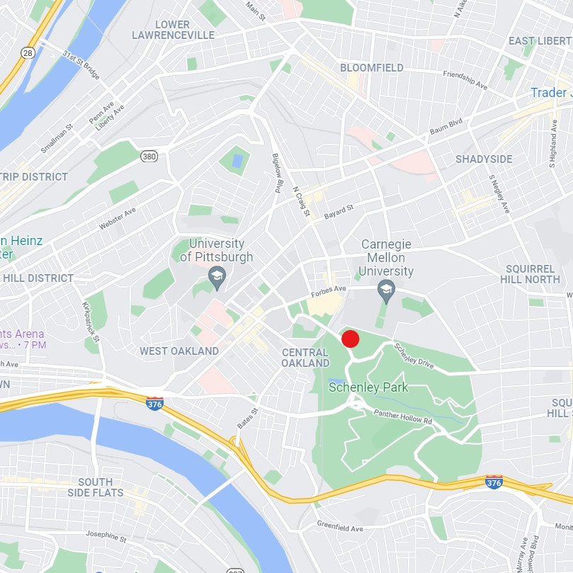
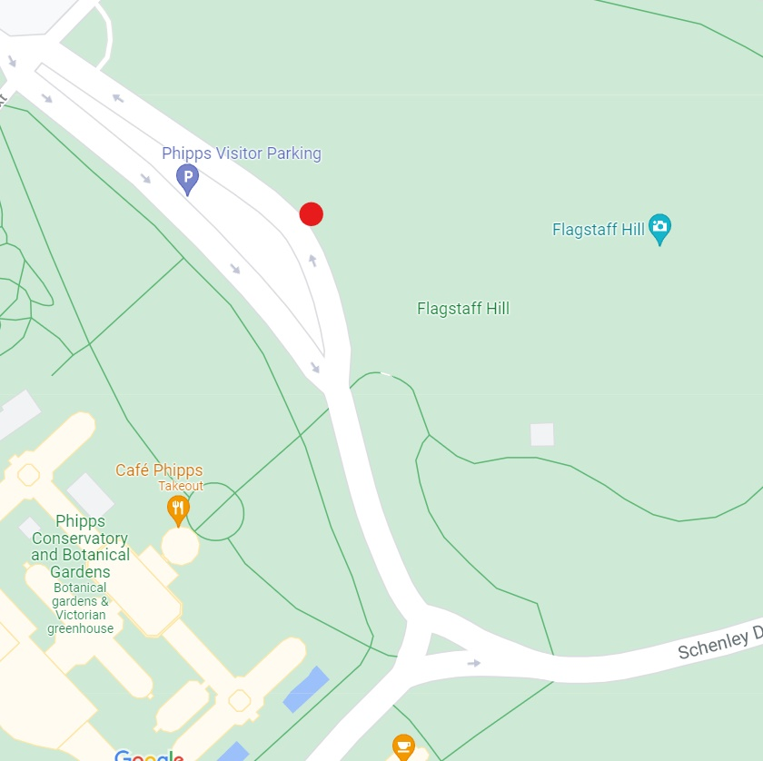
Project Location: Map
Provide one or more map images that identify the location of the project

Slide 4
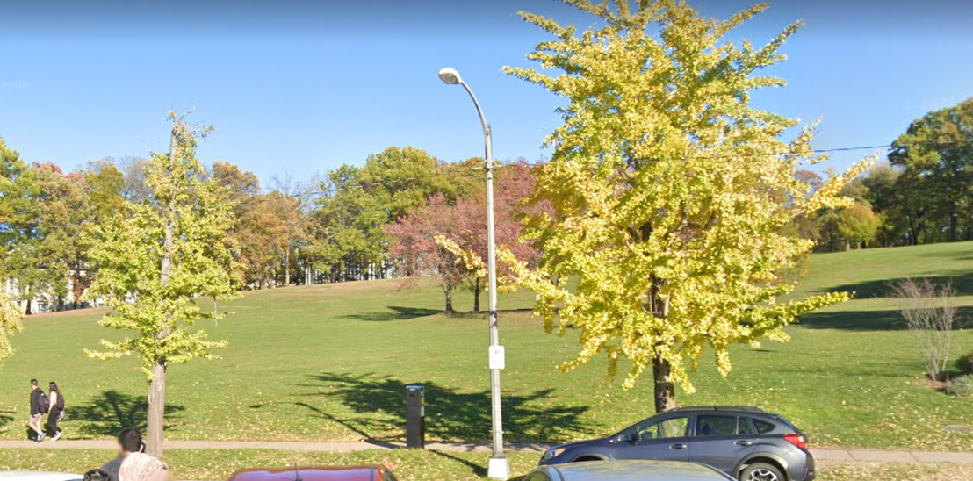
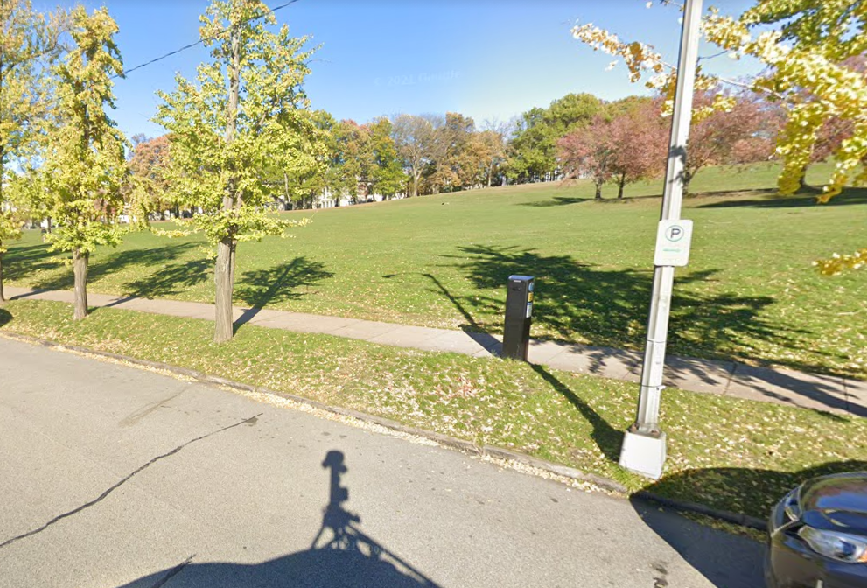

Project Location: Images
Provide images that show several views of the existing context of the site. (This will usually be multiple slides.)

Slide 5
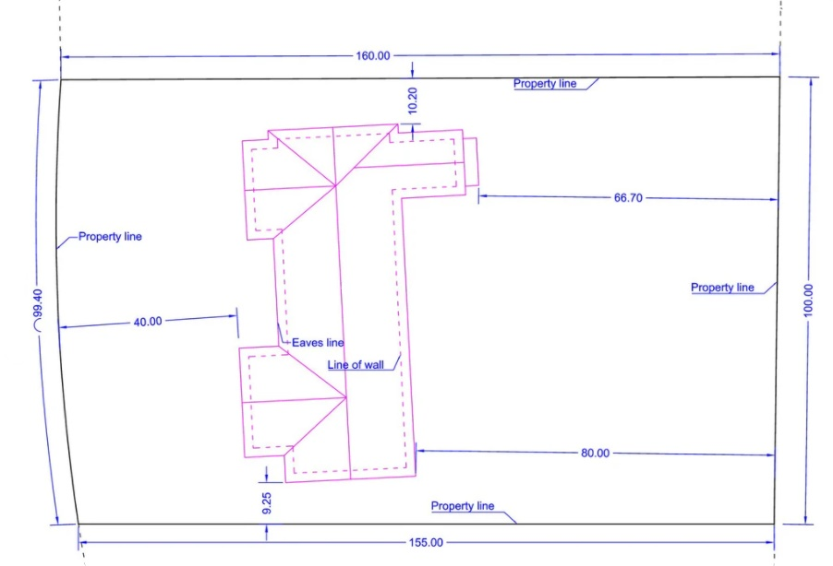
Project Location: Site Plan

Slide 6
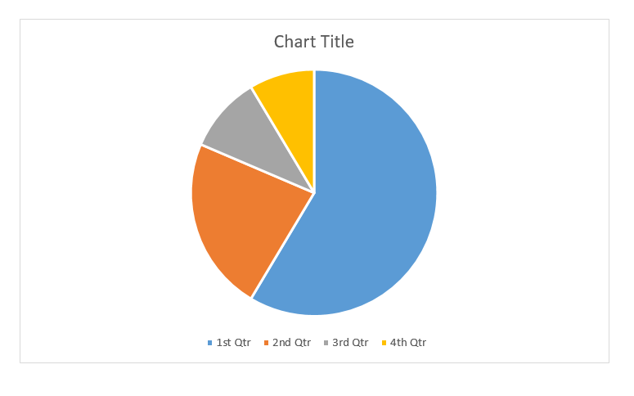


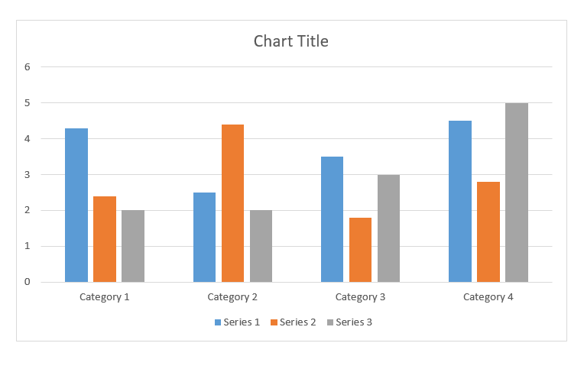
Project Background
Provide info and images that illustrate the history of the project to date. This may include reasons for the implementation of this project, community engagement and feedback, inspiration images, initial ideas and planning, or other details. (This will usually be multiple slides.)

Slide 7



Project Proposal
Provide info and images that illustrate exactly what is being proposed at this stage of the project. This may include conceptual sketches, technical drawings with dimensions, or other renderings. (This will usually be multiple slides.)
Scale
Rendering
Artist’s Concept Sketch
Detail

Slide 8

Project Proposal: In Situ
Provide one or more renderings that show how the project will appear when installed on site. The sizing should accurately reflect scale.

Slide 9



Project Proposal: Materials
Provide info and images detailing the materials, colors, and product specifications that will be used.

Slide 10
Conclusion / Other Info
Provide info about any future expectations or anticipated outcomes for the project. Outline who will be responsible for maintenance, how often it will be performed, and what the lifespan of the project will be.
Provide any other info or images necessary to understand the scope of the project.
Please see the Application Guidelines at the link below for details about what materials are expected to be included with an application and the criteria by which reviews will be made.
https://engage.pittsburghpa.gov/pacd-commission-application

